Slide 1

Array and Its methods

Slide 2
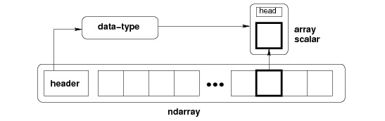
Arrays
NumPy is an N-dimensional array type called ndarray.
It describes the collection of items of the same type.
Items in the collection can be accessed using a zero-based index.
Every item in an ndarray takes the same size of block in the memory.
Each element in ndarray is an object of data-type object (called dtype).

Slide 3
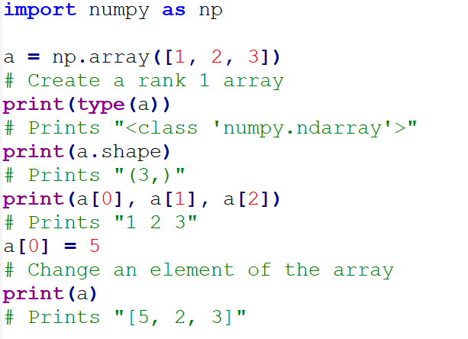
Array and its methods

Slide 4
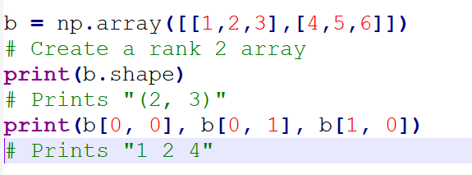
Cont..

Slide 5
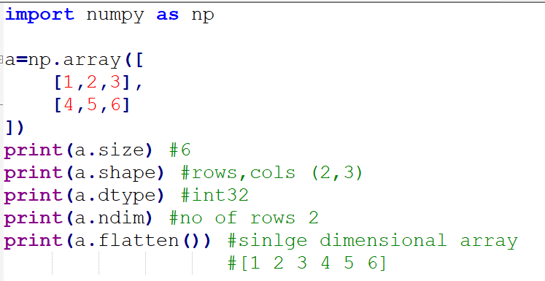
Cont..

Slide 6
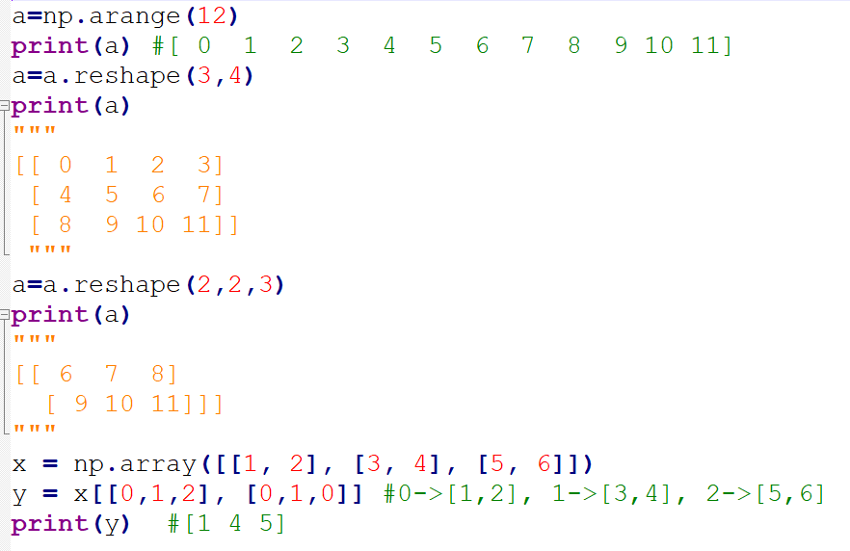
Cont..

Slide 7
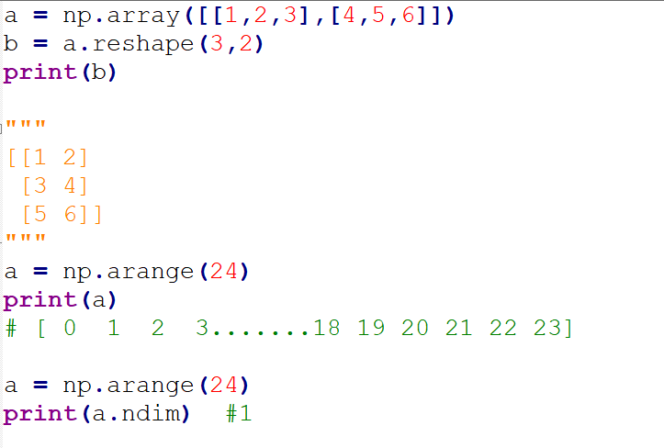
Cont..

Slide 8
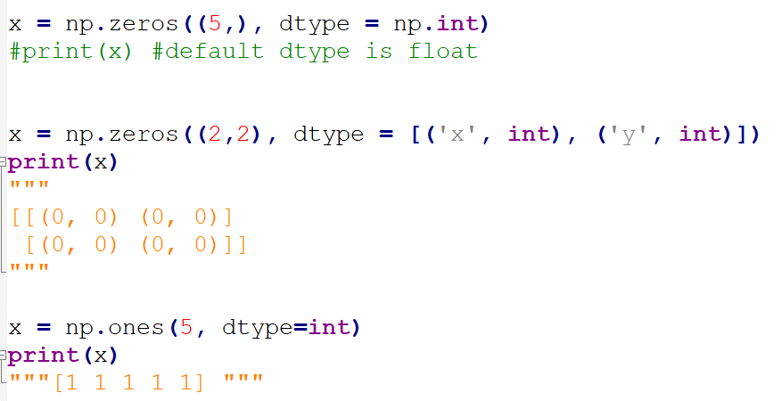
Cont..

Slide 9
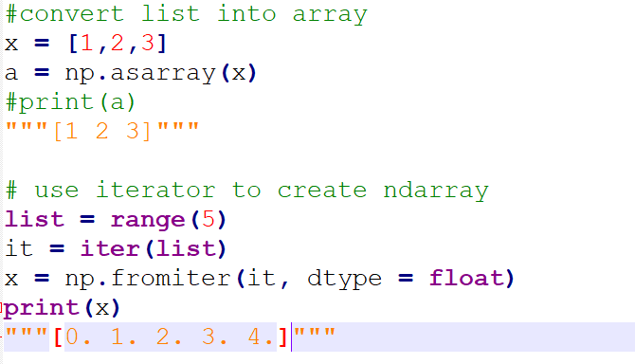
List vs Array

Slide 10
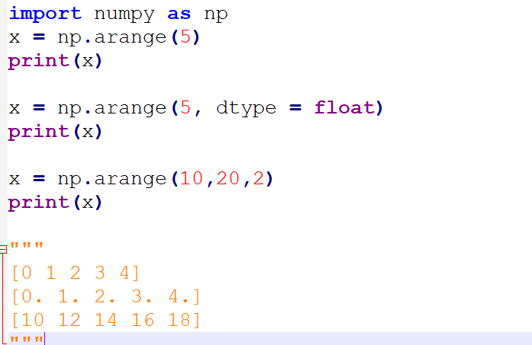
Numerical Ranges and Slicing

Slide 11
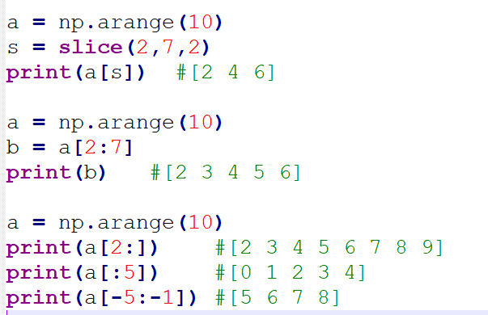
Array Slicing

Slide 12
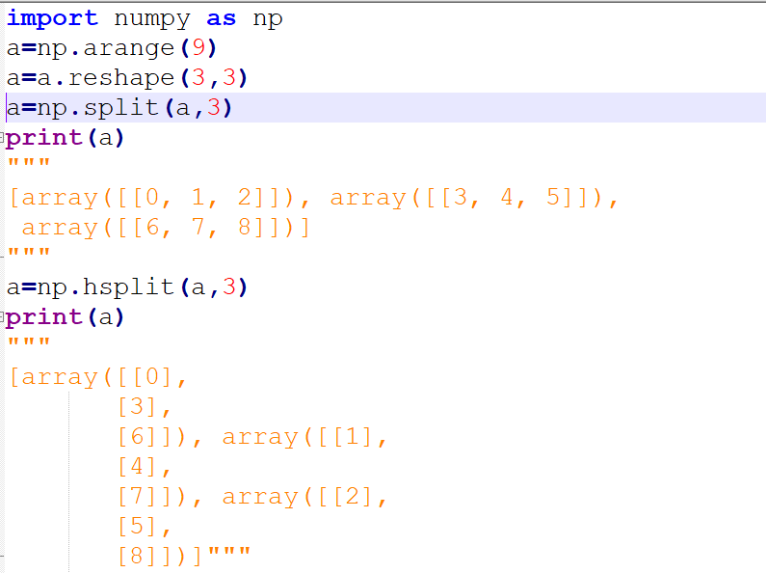
Array Split
Notes:
Check vsplit()

Slide 13
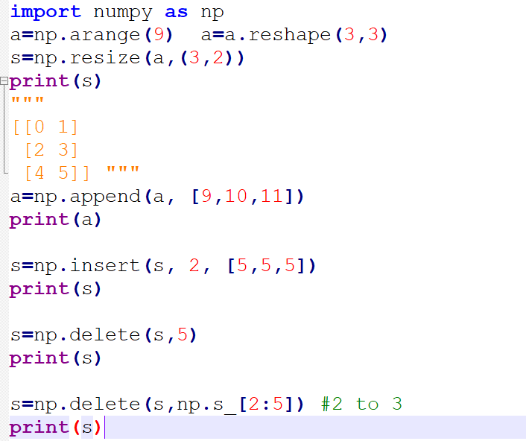
Array Manipulation

Slide 14
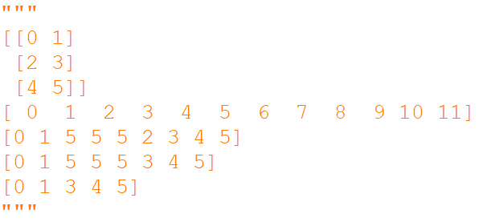
Ans..

Slide 15
Thank You

